Slide 1

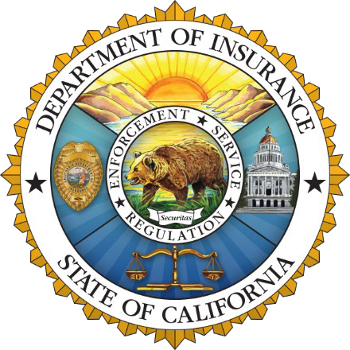
California Department of Insurance
Richie M Sayavong
Outreach Specialist
Community Relations and Outreach Branch
Notes:
Good evening everyone, thank you for the invitation to be here. My name is Richie Sayavong and I serve as a Northern CA Outreach Analyst at the CA Department of Insurance , which we refer to as CDI. Tonight I am going to give you updates on the insurance market. But first I am going to give you a facts about the Department, which we refer to as CDI.
CDI is the largest State Consumer Protection Agency in the US. And CA is also the largest insurance market in the US, and the 3rd or 4th largest insurance market in the world.
In 1988, as a result of Prop 103, CA Insurance Commissioner became an elected office, and the current Commissioner is Ricardo Lara. The Department uses its authority to:
However, the one thing we cannot do is to require or compel insurance companies to sell insurance to a particular person or community.

Slide 2

The Insurance Market
Inflation is creating unprecedented financial stress to insurance markets.
Increased costs of rebuilding, supplies, materials, auto parts along with labor shortages, among other costs, are affecting insurance markets.
Reinsurance is harder to find and is costlier as catastrophes grow around the world.
As risk grows, insurance markets are contracting to protect solvency, meet financial obligations and regulatory mandates.
Natural disasters & global inflation have increased insured losses and costs worldwide like never before.
Notes:
Let’s talk about where we are today
We are all aware of the stress on the insurance market right now that was created by a combination of natural disasters and global inflation. This is not just happening here – but every state is experiencing the same factors:
Increased costs for rebuilding
• Labor shortages
• Reinsurance, is harder to find and costlier.
• And as we’ve seen - as risk increases, insurance companies are protecting their obligations to current consumers and limiting new business and pulling back even further

Slide 3
California Context
Top 12 Companies =
85% of State’s Homeowners Market
The property insurance market in the country (specifically in large states like California) is changing quickly.
Since 2022 alone — 7 of top 12 insurance companies have paused or restricted new business despite rate increases approved or pending with Department of Insurance.
Notes:
Even though many insurance companies are currently still selling homeowners insurance in certain markets, 12 insurance groups control 85 percent of the California insurance market. Think about that.

Slide 4
California Context
Insurance Group and Ranking (2022) | Market Share | Major Actions in Homeowner Policies 2023
1. State Farm | 21.22% | Paused new policies and initiated non-renewal of 72,000 policies by 2025
2. Farmers (10 companies) | 14.9% | Writing new policies with 7,000 monthly limit
3. CSAA (2 companies) | 6.9% | Writing new policies with no change
4. Liberty Mutual (6 companies) | 6.6% | Writing new policies with no change
5. Mercury | 6% | Writing new policies with no change
6. Allstate (5 companies) | 6% | Paused new policies. Rate increase application (pending)
7. USAA (4 companies) | 5.7% | Restricted underwriting to low-risk only
8. Auto Club | 5.1% | Writing new policies with no change
9. Travelers | 4.2% | Limited new policies. Rate increase application (pending)
10. American Family (3 companies) | 2.8% | Writing new policies with no change
11. Nationwide (2 companies) | 2.5% | Limited new policies
12. Chubb (8 companies) | 2.2% | Ceased writing high-value homes with higher wildfire risk, and non-renewed some high-value homes
Notes:
AND, Since 2022 – 7 of those top 12 insurance groups have paused or restricted new business despite rate increases approved, or pending with CDI. And I am sure you are aware that State Farm has chosen to non-renew 30,000 policies within certain zip codes starting this summer.
So clearly this problem is complex and global in nature – affecting all of us. And cannot be solved by just increasing prices alone.

Slide 5
How did we get here?
FAIR Plan has increased to more than 4% of CA market – becoming the insurer of first resort, not last resort, for many.
AM Best downgraded outlooks for Top-12 companies like State Farm, AAA, Mercury due to risk concentration in California.
Insurance companies will not write in high-risk areas, unless they can cover 100% of consumer claims, their expenses, and earn a fair return.
Rate filings are more complex and can take longer than 6 months to review.
One entity can unreasonably prolong rate filings – no other state has this.
Notes:
So, HOW DID WE GET HERE?
• The FAIR Plan has doubled to more than 4% of the market — becoming the insurer of first resort for many Californians, not the last resort as it was designed.
• As many of you know, the FAIR Plan is not a state agency, it is run and funded by the insurance companies.
FAIR Plan policyholders are required to pay more for less coverage. The FAIR Plan only covers, Fire, Lightning, Smoke, Internal Explosions so homeowners also purchase a Difference in Conditions policy to make up the difference
• As a direct result of growing risk concentration in California, the credit rating agency AM Best has downgraded outlooks for Top-12 companies like State Farm, AAA and Mercury.
Insurance companies will not write in high-risk area unless they can cover 100% of consumer claims, their expenses, and earn a fair return.
Rate filings are more complex and can take longer than 6 months to review
And one entity can prolong a rate filing – no other state allows this.
Prices have increased nationally. CDI’s goa is to get back to a point where insurance companies are competing for your business to drive down the cost. California still has lower rates than Texas and Florida. Our rates rank right in the middle nationally. But risk continues to increase – to the point where insurance is becoming unaffordable for some, and we recognize that.
• And unfortunately: Unlike public utilities which are required to provide coverage to all residents and businesses, under Proposition 103 insurance companies can legally refuse to write insurance unless they are able to meet 100% of consumers’ claims, cover their expenses, and earn a fair return.
Everyone is harmed if an insurance company goes insolvent because it cannot pay its claims. And we want to make sure that does not happen.

Slide 6
Safer From Wildfires
Protect your home or business
+
Protect the immediate surroundings
+
Protect the whole community
Notes:
To reduce the risk of major losses in the industry Commissioner Lara introduced the Safer from Wildfires framework
It is a three step system to protect your home, surroundings and community which in turn provides consumers with discounts and transparency about your risk rating.
Under this regulation we expect to see:
More businesses, homeowners and communities making investments in wildfire safety
Greater community resilience
Reduced losses from wildfires
More insurance coverage for mitigated properties
This regulation attacks the root cause of non-renewals – which is wildfire risk – and they will make Californians safer.
And with accurate pricing of insurance, we expect to see more insurance options for people through a more competitive market.
Step One is pretty straight forward,
Class-A Fire Rated Roof,
5 foot ember-resistant zone around the structure
Enclosed Eaves,
Fire-Resistant Vents,
Multi-pane windows or shutters that close
A minimum of 6” noncombustible vertical clearance at the bottom of the exterior surface of the structure.
Step Two – protect the immediate surroundings.
Clear the vegetation and debris from under decks and any and all movable combustible materials from within 5 feet of the Building Being Evaluated. (The BBE)
Remove all combustible structures, sheds and other outbuildings from the immediate surroundings of the home, to at least a distance of 30 feet.
And of course trim your trees and remove brush in compliance with state and local ordinances.
And finally, step three is an effort to obtain a community-level mitigation designation. This usually involves at least one, if not more, local government agencies, (such as OES, Fire Dept). Such as a Firewise USA site in Good Standing and the FRRC (Fire Risk Reduction Community) by the Board of Forestry.

Slide 7
CA FAIR Plan & Wildfire Risk Score
Since August 2023, the CA FAIR Plan began offering insurance discounts
The CA FAIR Plan is offering 20 million dollar coverage per location for commercial policies, including HOAs
The Wildfire Risk Score regulations allows consumers to request and appeal your property risk score
Notes:
When you do the mitigation steps, your insurance company will provide you a discount. The CA FAIR Plan began offering insurance discounts, on August 23rd of 2023. and CDI is working to continue approving the other companies. (the rate filings are public on our website - https://interactive.web.insurance.ca.gov/apex_extprd/f?p=186:1:6851524530905:::::
The FAIR Plan has offered a 10% discount on policies in a participating Firewise Community since May 2018. And now, the FAIR Plan is offering two more wildfire hardening discounts: one for Protecting the Structure, and another for Protecting the Immediate Surroundings of the dwelling. When applied, these discounts will reduce the wildfire portion of the policy’s premium by 10% and 5% respectively, up to a total of 14 ½%. Homeowners should contact their broker to find out how to qualify and when they could receive a discount.
Additionally, CDI and the CA FAIR Plan reached an agreement to increase the commercial coverage limit to $20 million per location (effective November 1, 2023), and they recently agreed to a $20 million structure increase. This addressed the greater needs for additional coverage for recreational youth camps, HOAs, wineries, and agricultural groups. And the business owner’s policy (BOP) limit also increased to $20M on December 14th.
Another important aspect of the SFW regulation is that while traveling throughout the state, people did not know that insurance companies assign a risk score to your home or business. It is important to get that score because if you know about the risks on your home and property, you can take action to reduce them and make yourself and your neighbors safer.
This Regulation requires insurance companies to give you that score and they have to tell you how they created that score and what factors went into it.
The wildfire risk score or classification must be provided at the following times:
• (within 15 days) of When you apply for a new policy
• (at least 45 days) Before you renew a policy
• (at least 75 days) Before you are non-renewed
• And (within 30 days) of When you complete mitigation on your property and request a revised score
And lastly, the regulation for the first time gives you the right to appeal. And, if you are not satisfied with the response, please contact CDI and fill out a Request for Assistance.

Slide 8
Sustainable Insurance Strategy
A comprehensive plan to help solve the California insurance crisis
Informed by community input and data
Insurers are committing to write and expand in high wildfire risk areas across the state — in a rate filing reviewed by the Department
Depopulate the FAIR Plan
2

Slide 9
Catastrophe models lead to greater safety and better risk assessment
Account for individual, community, and statewide mitigation.
Recognize changing conditions such as climate and real estate development in high risk wildfire areas.
Better management of catastrophic risk and premium accuracy.
3
Notes:
The Governor’s Executive Order last September led the Commissioner to expedite another package of regulatory solutions. CDI introduced California’s Sustainable Insurance Strategy (SIS), a comprehensive plan to modernize our insurance market.
Here are the executive actions and reforms we are taking:
Increase availability of insurance in wildfire distressed areas. Using our prior approval rate authority, insurance companies will write no less than 85 percent of homes and businesses in wildfire distressed areas. This is a historic agreement between the Department and insurance companies.
This will reverse the trend of a growing FAIR Plan and close the insurance gap. and return FAIR Plan policyholders back to traditional insurance
The Department will define these distressed areas using a data-driven approach.
The next important element of the plan directly addresses the climate crisis.
The Department introduced the use of forward-looking catastrophe models, the CAT Modeling, which prioritizes wildfire safety, mitigation, and transparency.
Looking only to the past does not recognize the massive investments in wildfire safety being made by our state and local governments, public and private utilities, and homeowners.
The regulation has four important benefits for consumers:
The first consumer benefit is more reliable rates: Insurance consumers will see more sustainable costs than under current regulations.
The second consumer benefit - is greater availability of insurance: Insurance companies will increase their writing because they can better anticipate future losses, rather than non-renewing higher-risk policyholders or pausing writing altogether.
The third consumer benefit - is safer communities: CAT models can capture the benefit of wildfire mitigation, encouraging and rewarding those efforts.
The final consumer benefit - is stronger oversight by the Department of Insurance experts. Models are already being widely used by insurance companies outside of rate-making and across the nation. The Department will have access to models, so California continues to lead on consumer protection.
AND we have received notice from AllState that if and when this regulation occurs, they will start writing policies in CA again.
Allstate is one of California’s biggest companies, and that is good news.
Farmers, which is the second largest homeowners and commercial writer in the state, has reopened its condo and apartment coverage.

Slide 10
Guiding principles
Maximize geographic relief to insurance consumers.
Define distressed areas of the state in a way that is clear, understandable, and addresses FAIR Plan growth.
Monitor distressed areas annually and focus on expanding insurance access for distressed properties.
4

Slide 11
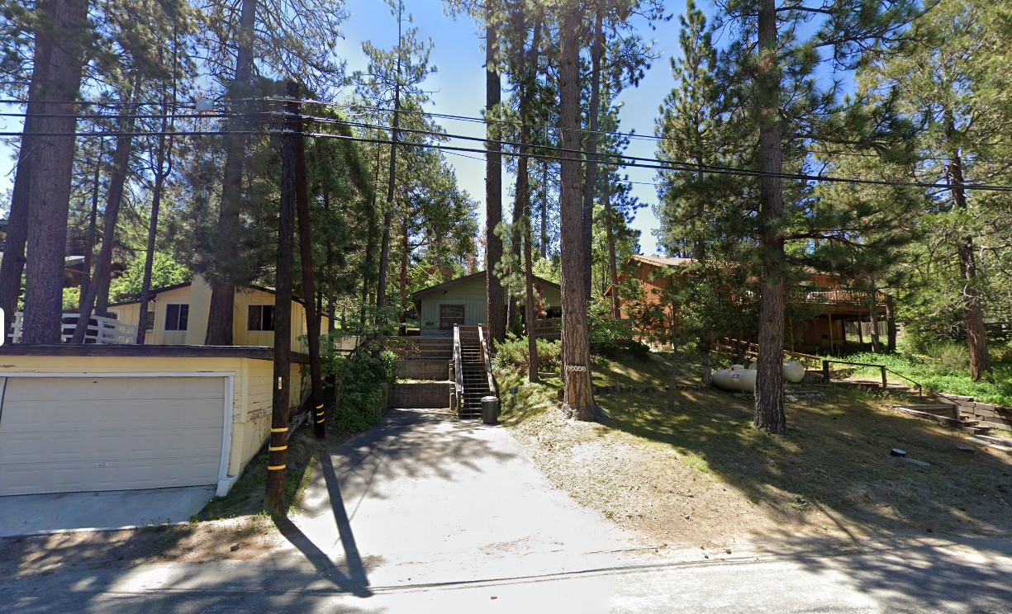
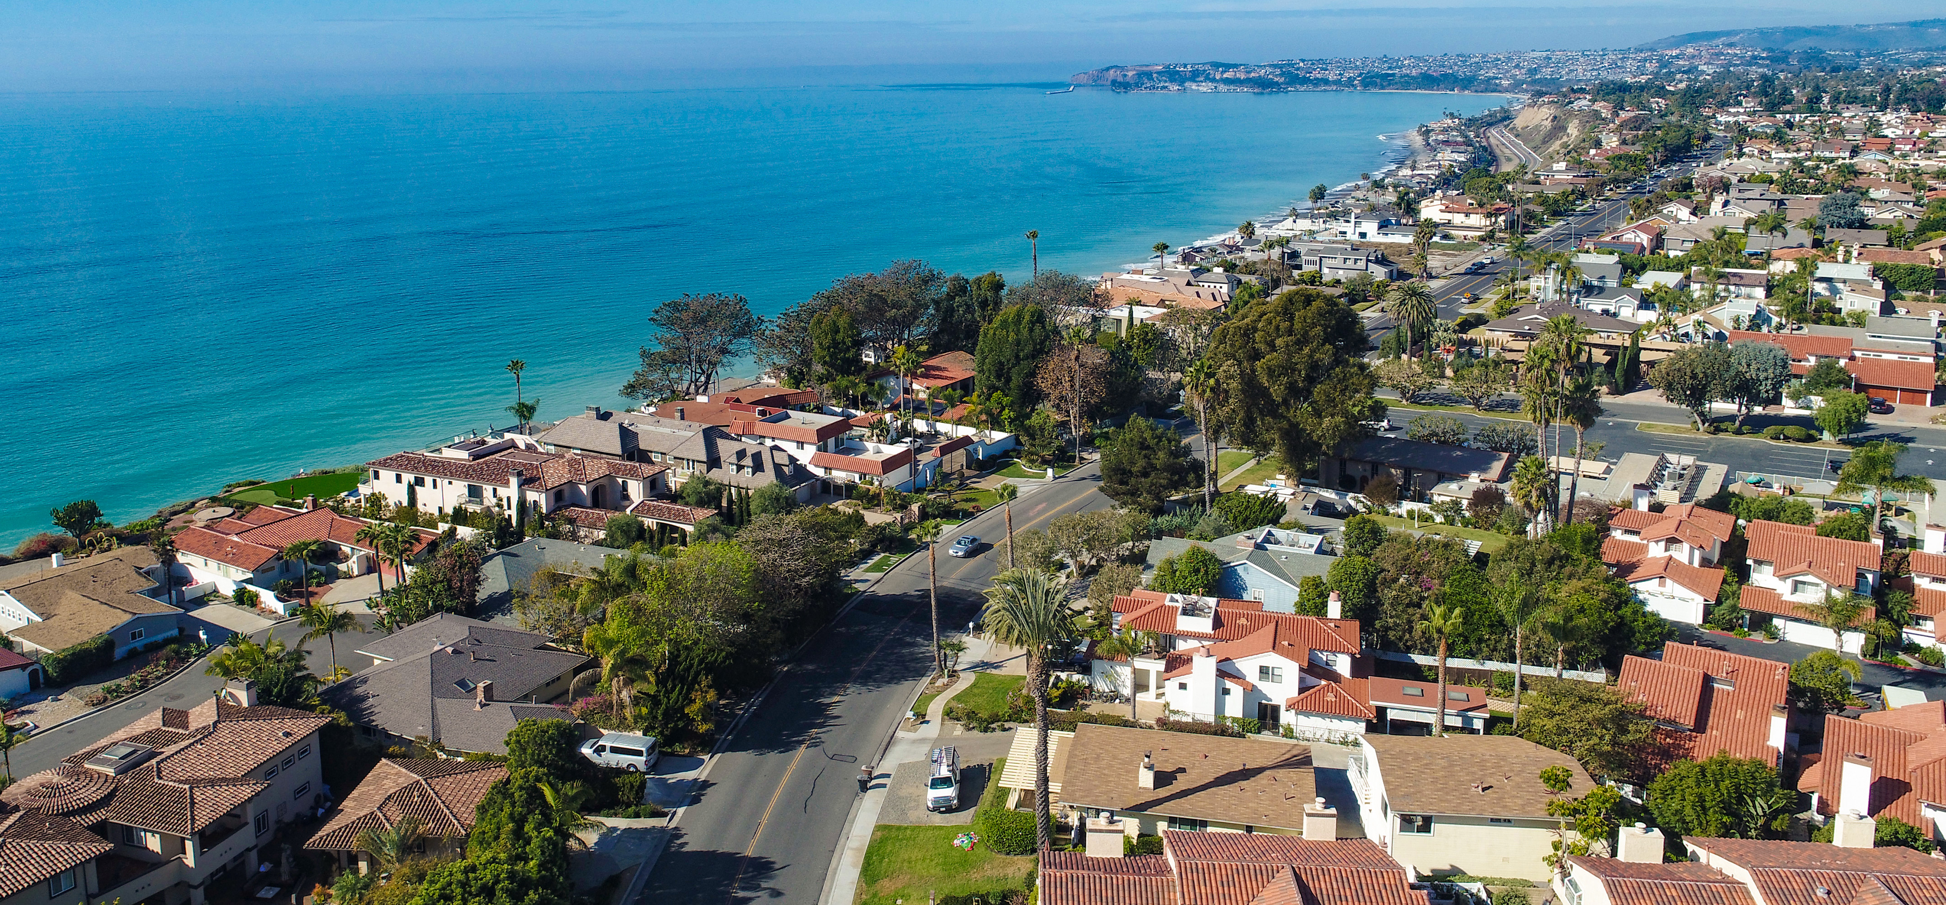
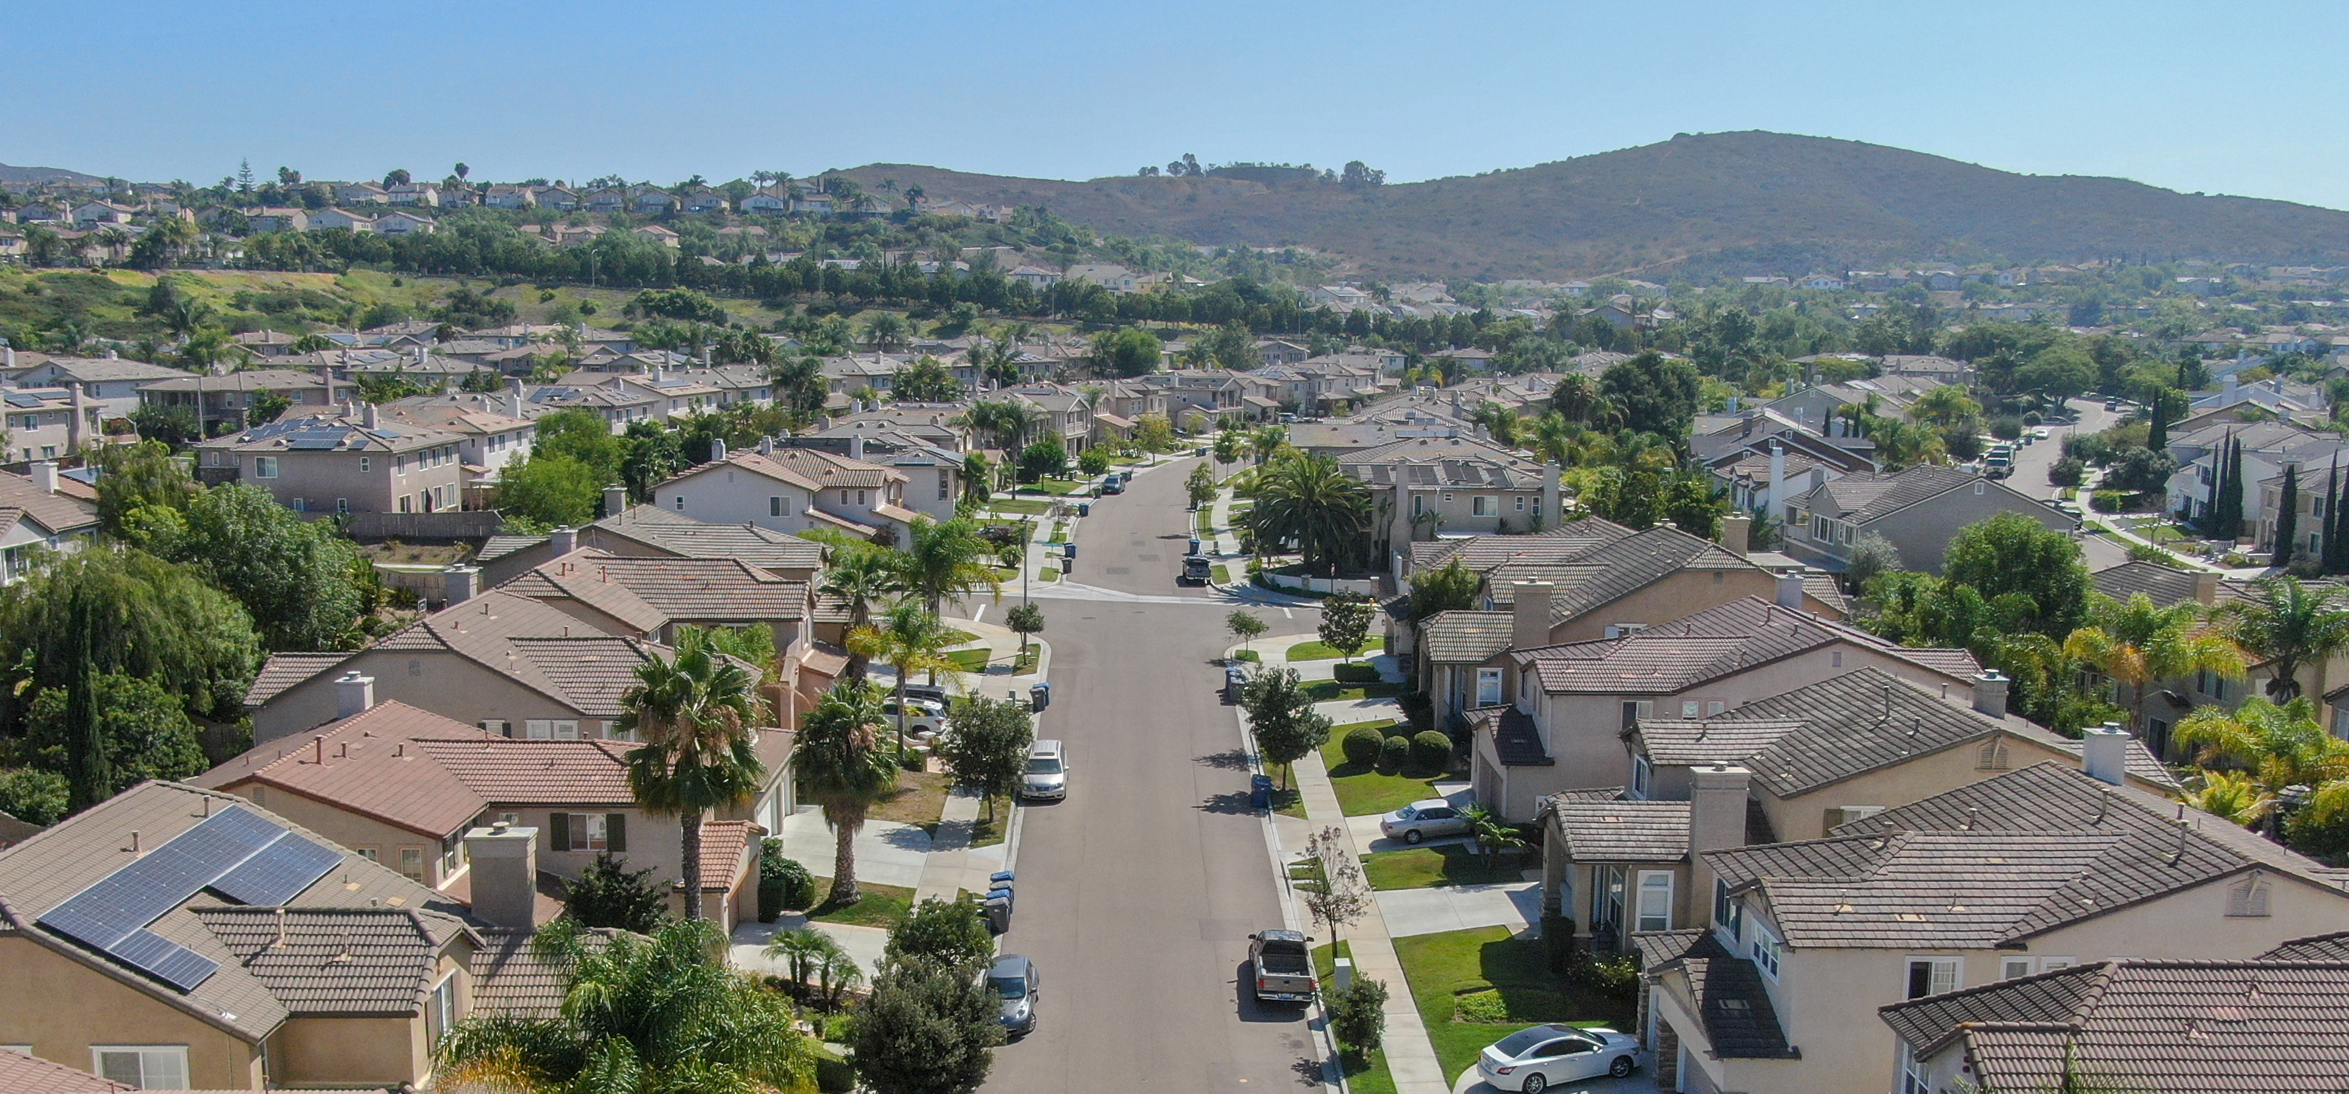
Hybrid approach to help consumers
California’s complex geography and insurance market require taking multiple approaches to help the most people.

Slide 12
ZIP Codes
"High" and "Very High" fire hazard categories based on most recent
CAL FIRE maps
FAIR Plan concentration rate of 15% or higher
Affordability index for income-eligible in high and very high fire hazard area categories — based on the cost of coverage
6

Slide 13
Counties
Wildfire Risk Scores: If 20% or more of properties in a county are in a high risk area (i.e. 1 out of 5 structures)
20% threshold helps prevent “cherry picking” in low risk urban areas
7

Slide 14
FAIR Plan policies facing wildfire risk
Pockets of FAIR Plan policies exist in nearly every county.
As part of new growth benchmarks, insurance companies will take FAIR Plan policies in Northern, Central, and Southern California.
8

Slide 15
What this means for Californians:
First Approach | Second Approach | Third Approach
ZIP Codes with greater than 15% FAIR Plan policies or affordability index Minimum 85% policies written in traditional market 5% growth of writing | Counties with greater than 20% of properties at risk Minimum 85% policies written in traditional market 5% growth of writing | FAIR Plan policies statewide in wildfire risk areas 5% growth of writing to take policies out of FAIR Plan
More coverage options and fewer FAIR Plan policies in areas of higher risk
12

Slide 16
The Department of Insurance's enforcement authority
Under existing law, the Department can do a market conduct exam and audit insurance companies if they fail to meet the requirement.
Conduct rate hearing, which can lead to a rate adjustment or refunds.
Prevent insurance companies from using catastrophe models.
13

Slide 17
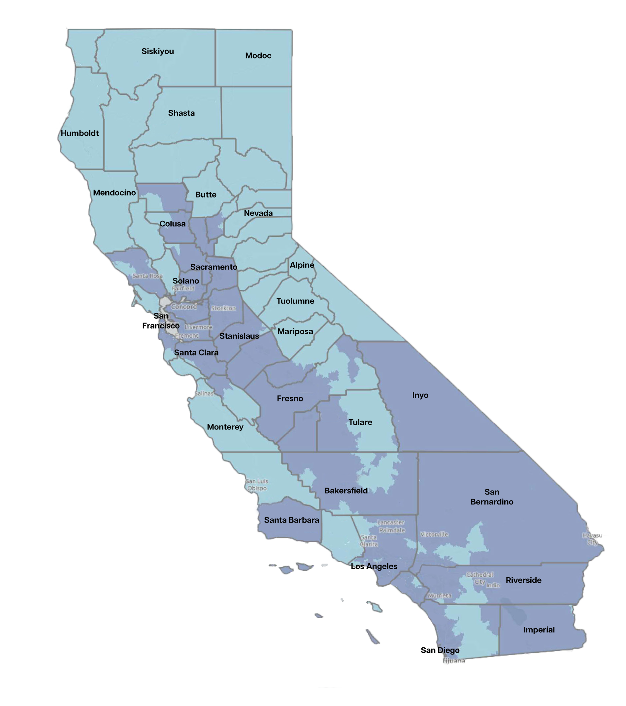
Concentration of FAIR Plan policies and wildfire risk
Areas of higher concentration of
FAIR Plan policies
and wildfire risk
Areas of lower concentration of
FAIR Plan policies
and wildfire risk
9
Notes:
A preliminary list of Distressed Counties has been drawn up, and as you can see most of Northern CA is in it. Mono County is currently ranked no 11 out of 28.

Slide 18
Questions?
File a Complaint
1-800-927-4357
insurance.ca.gov
Consumer Alerts

