Slide 1
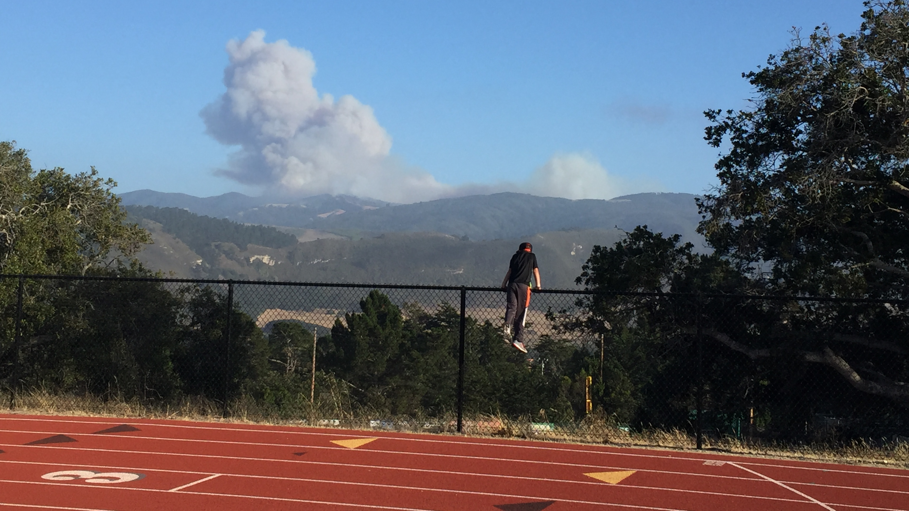
Wildfire Community Preparation
Homeowner Responsibilities
May 13, 2025

Slide 2

The council is a non-profit corporation committed to reducing the risk of loss of life, property and resources from wildfires via education, outreach and supportive programs.
https://www.firesafemonterey.org

Slide 3
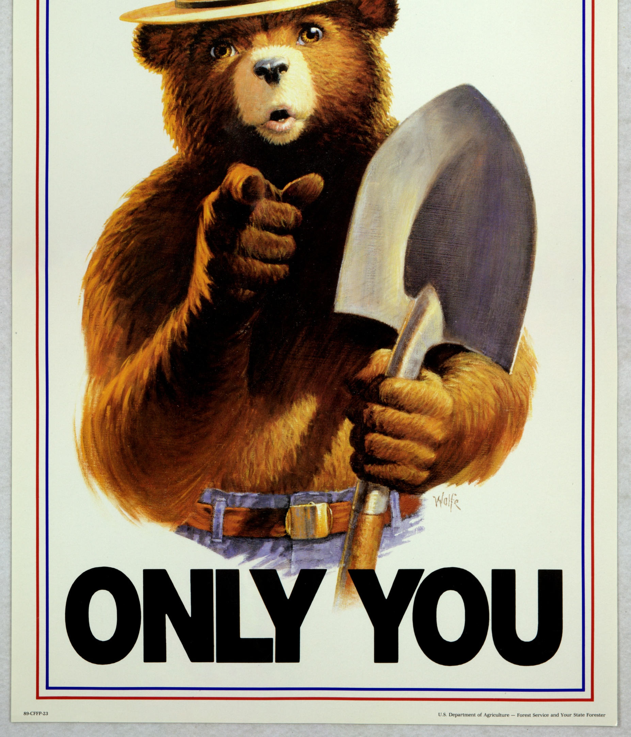
Can Prevent Wildfires
1944

Slide 4
Can Prevent
Home Ignitions
2025

Slide 5
It is the homeowner’s responsibility to prevent their home from igniting.
Preventing the homes from igniting means fire protection resources can be applied to containing the wildfire rather than attempting to douse multiple structure fires and contain the wildfire

Slide 6

Complimentary approaches to wildland fires and community protection.
From the wildlands in «
From the home out »

Slide 7
From the wildlands in «
Emphasis on fire suppression & forest management.
To limit or stop fire fronts before they reach the community.
Very costly option.
Embers can not be completely eliminated.

Slide 8
From the home out »
Emphasis on the Home Ignition Zone (HIZ):
Making the homes themselves more fire resistant.
Zone Zero.
Eliminate ember traps.

Slide 9
Firewise embodies the home out approach, performed on a community scale.

Slide 10
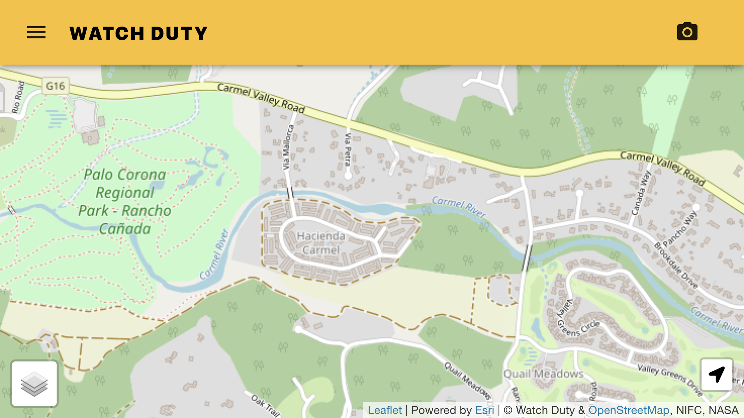
Firewise Community Boundary Map

Slide 11
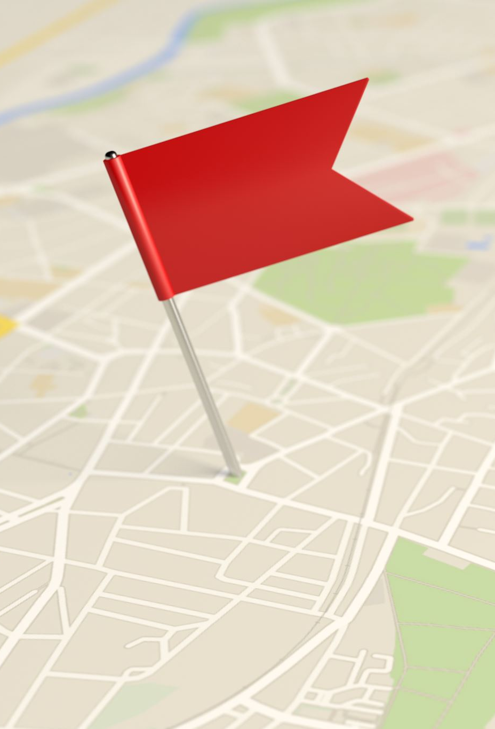
Firewise Community Boundary Map
Represents the community area of:
Responsibility
Sphere of Influence
Wildfire buffer/resilience
Required along with Firewise certificate to access WF insurance discount
Required third component of Firewise Application

Slide 12

Where to begin:
https://www.firesafemonterey.org/firewise-usa.html
Jennifer Valadez
jenv.fscmc@gmail.com

